Slide 1
Grover on Cipher
(Case study: Sudoku Game)
Game Demonstration on Grover search, Quantum Noise Reduction
Authors:
Sumanta Chakraborty
Shahrokh Rezaei
Gael-Pacome Nguimeya Tematio
Owais Ishtiaq Siddiqui

Slide 2
Grover and Cipher?
Sudoku is a graph coloring problem where graph edges must connect nodes of different colors. In our case, graph nodes are puzzle squares and colors are the Sudoku numbers. Graph edges are the constraints preventing squares from having the same values. It is a novel approach for encrypting images using a Sudoku as its encryption key.
Grover’s algorithm is a powerful tool that can be used to solve a variety of problems. For example, it can be used to find patterns in data, break cryptographic keys, and solve optimization problems. As quantum computers become more powerful, Grover’s algorithm will become increasingly important

Slide 3
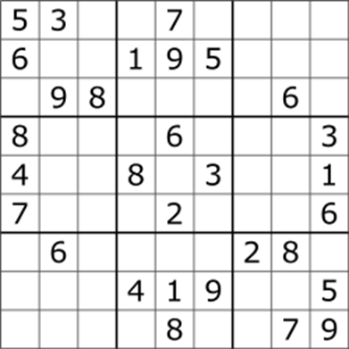
Game Overview
We have a square table with numbers in each cell. Some of the numbers we know, others are unknown. We search such a combination that in each row and each column there are no repeating numbers.
It's a combinatorial, number placing puzzle
The objective is to place numbers from 1 through 9, exactly once in each column, row and 3x3 subgrid
Gets easier as the number of digits already filled increases

Slide 4
Idea behind the Game
Our game is built to demonstrate how Grover search works.
Grover search is a quantum algorithm which finds the search key out of N distinct values with high probability in O(n^(1/2)) time.
In the Grover’s algorithm, the oracle contains real-world logic and translate it for the quantum computer. In this article we show how to create an oracle based on the Sudoku's rules. The rules state: in each line and column there must be only distinct numbers. In the case of a 2 by 2 Sudoku, there are four clause rules: v₀≠ v₁, v₀≠ v₂, v₁≠ v₃, v₂≠ v₃.

Slide 5
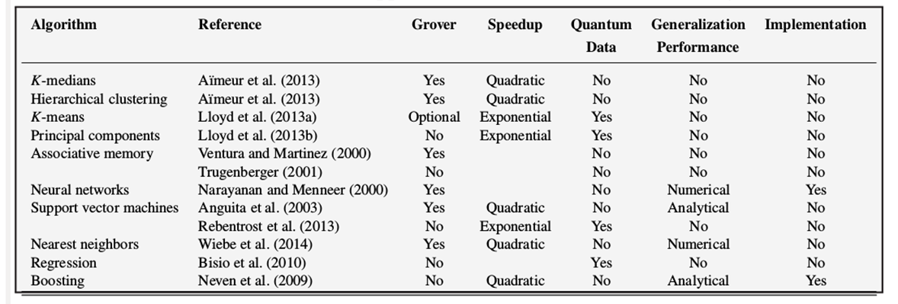
Problems we can solve right now with Quantum Computer

Slide 6
Why QisKit?
This game focuses on the IBM’s QisKit. QisKit proposes a complete learning environment, allowing a better understanding of quantum computing. It consists of several tools, one of which is a python library. It allows composing and running algorithms either on a quantum computer, or on a simulator.

Slide 7
Implementation…
The State Preparation is the first step in the Grover's method that we implement. It puts qubits in their proper beginning states.
Qubits must then be prepared in the desired beginning states. To the value register, we apply Hadamard gates. Through all conceivable states, this process generates a uniform distribution of amplitude.
The XOR operation is then defined, taking four arguments: a quantum circuit, two input qubits, and one output qubit.
The Amplitude Amplification operation, often known as the diffuser, is the next element in the algorithm. Its job is to identify states when the amplitude has a unique phase from other states and to expand its module. It enhances the likelihood of measuring the right answer.

Slide 8
…Implementation
5. The Diffuser implementation consists of a multi-controlled Z gate, a row of NOT and Hadamard gates, a row of Hadamard gates, and a row of NOT gates. We won't add the v2 qubit to the diffuser if some values are predetermined, like v2=1, for example.
6. The body of the algorithm can be constructed once all the bricks have been implemented. We'll think about two separate cases. First, there are two possible right answers because all four cells are empty: 0110 and 1001. In the second case, just one number, v1 = 0, is known, and there is only one viable outcome.

Slide 9
Algorithm
Before the first barrier, data initialization, the first oracle application, and a diffuser (amplitude amplification) make up the first part of the algorithm.
The second oracle application, the second diffuser, and the measurement of the value qubits to the conventional register are included in the subsequent part of the algorithm.
We start a backend after merging all of the actions on the quantum circuit. As a backend, we can employ a simulator or a quantum computer. The quantum circuit is then transpiled into a format that the simulator can understand. We put it together, do the calculations, and then visualize the outcomes on a histogram. By default, the method performs 1024 calculations with each run in order to collect data on the outcomes.

Slide 10
Running on simulator
The free quantum computers offered by IBM only contain five qubits. We require nine in order to fully construct our method. Nevertheless, we have access to a simulator that can simulate hundreds of qubits.

Slide 11
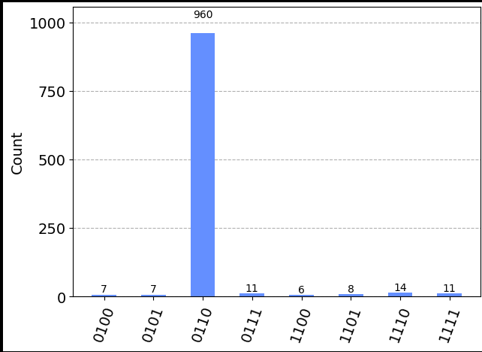
Analysis of the Quantum solution
The histogram displays the probabilities in the scenario when v1 = 0 is the only known value. The total number of alternative states in this situation is split by two. As expected, there is just one valid response: 0110.

Slide 12
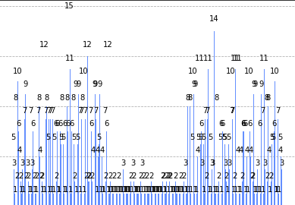
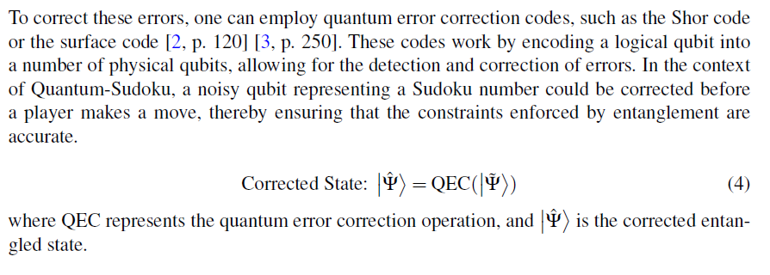
Future (Noise Reduction Schematic)

Slide 13
Thank You
Q&A

